Slide 1
Strengthening Regional Cooperation on Skills Development under the CAREC Program: Key Progress, Challenges, and Opportunities for Collaboration Inception Meeting and International Expert Roundtable 30–31 May 2022, Tbilisi, Georgia
Ministry of Employment and
Labor Relations of the Republic of Uzbekistan
Managing labor migration and pre-departure training in Uzbekistan
Zokhidjon Askarov
2022

Slide 2
THE SYSTEM OF SAFE, ORDERLY AND LEGAL LABOR MIGRATION
POPULATION DEMOGRAPHY
EMPLOYMENT
UNEMPLOYMENT
Number of Population mln.
Rate of unemployment
43,6
9,3%
10,5%
9,6%
9,2%
NUMBER OF LABOR RESOURCES
45,1%
9,0%
33,9
45,1%
20,6
Economically active population
Economically inactive population
13,7
41,6%
13,3%
22,6%
41,6%
2018 y.
2019 y.
2020 y.
2021 y.
2022 y. 1st - quarter
1990 y.
2020 y.
2035 y.
19,4
Number of employment people
54,1%
77,4%
in official sector
in informal sector
labor migration
15,1%
18,7 mln. People
Youth generation
57%
Economically active population
43%
Men
Women
49,5%
13,5
13,5
13,7
13,3%
13,3
13,2
17,1 mln. People
Women
Number of Employed population mln.
2018 y.
2019 y.
2020 y.
2021 y.
2022 y. 1st – quarter
Ministry of Employment and Labor Relations of the Republic of Uzbekistan

Slide 3
THE SYSTEM OF SAFE, ORDERLY AND LEGAL LABOR MIGRATION
Ministry of Employment and Labor Relations of the Republic of Uzbekistan

Slide 4
INTRODUCTION OF PROFESSIONAL SKILLS AND FOREIGN LANGUAGES, RETRAINING
In Uzbekistan
16 monocenters "Ishga Markhamat"
70 vocational training centers
37 short-term training courses
136 training centers in the neighborhoods
13 colleges in the field of construction
368 colleges under various ministries and private educational institutions
2020 year
21 437
TRAINED
2021 year
52 632
Ministry of Employment and Labor Relations of the Republic of Uzbekistan
2022 year
17 435

Slide 5
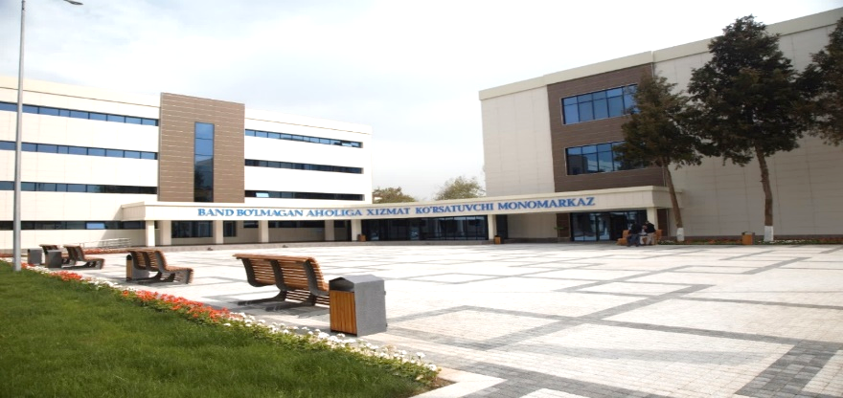
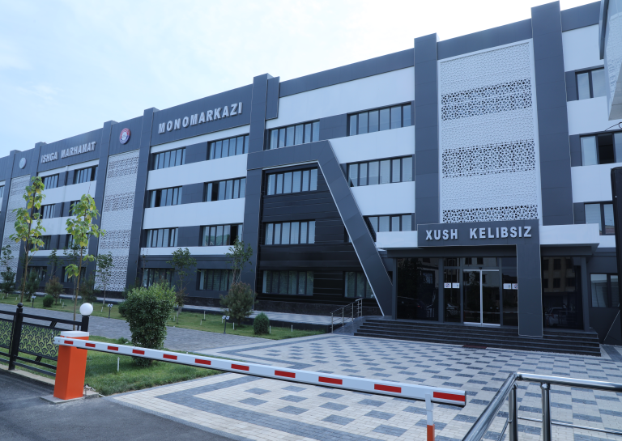
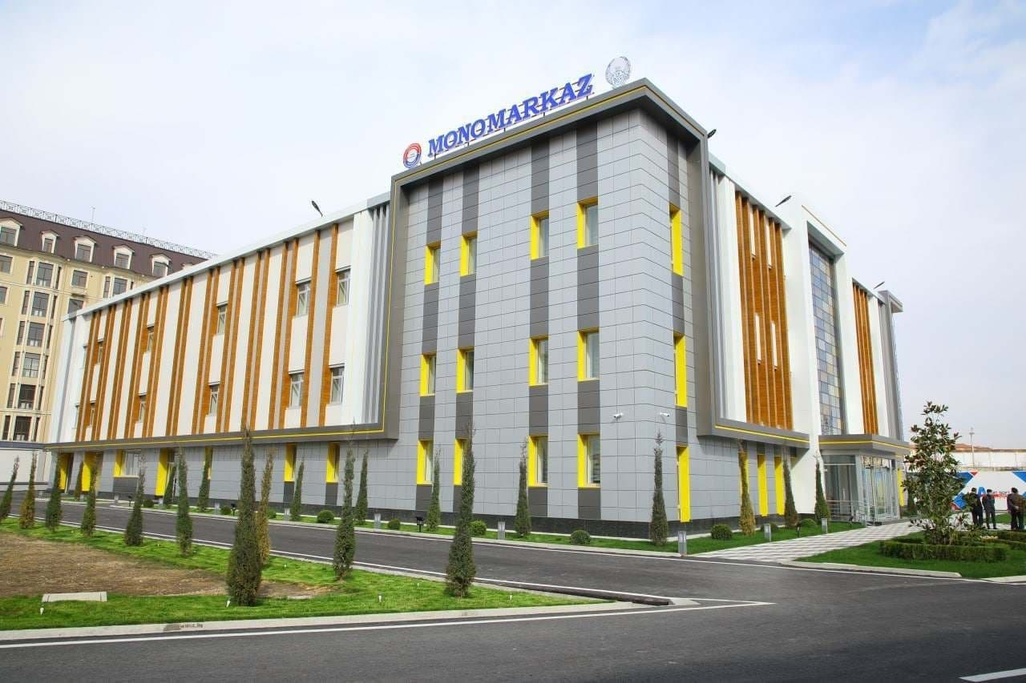
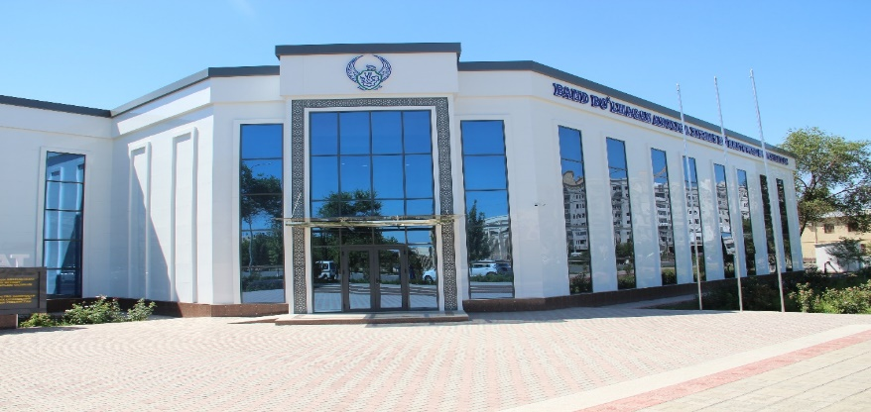
REGIONAL MONOCENTERS "ISHGA MARHAMAT"
Tashkent city
Andijan region
Namangan region
Khorazm region
Ministry of Employment and Labor Relations of the Republic of Uzbekistan

Slide 6
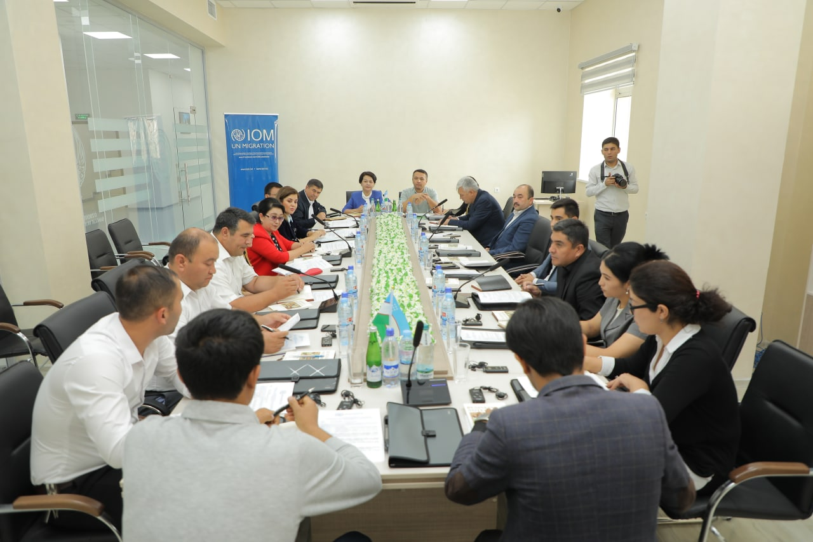
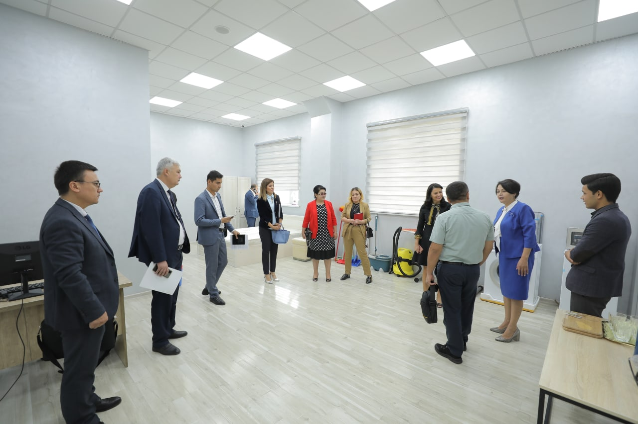
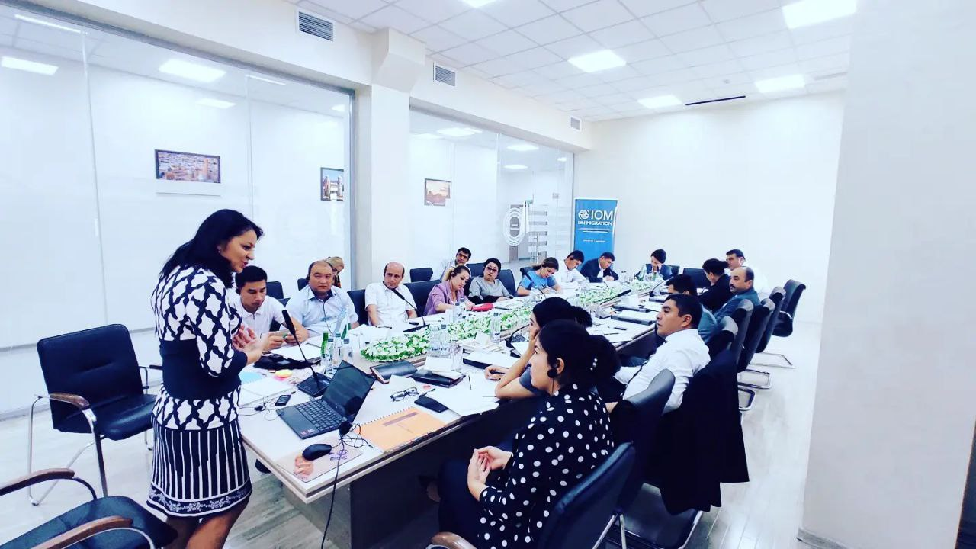
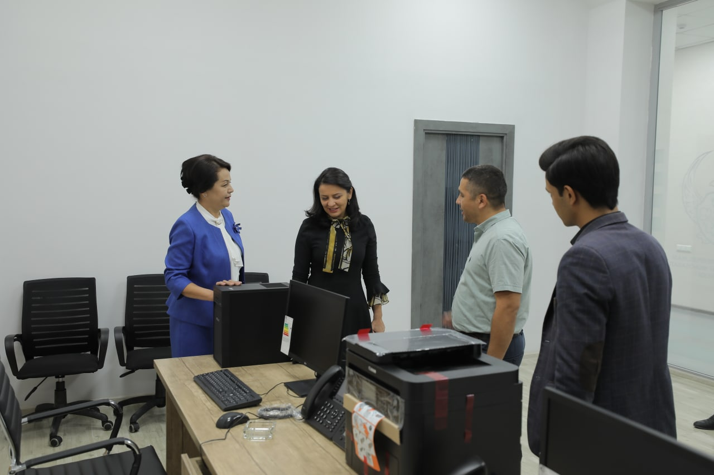
Project of IOM “Establishing a Pilot Skills Development Centre for Potential Labour Migrants” and a training seminar was organized for trainers in Namangan “Ishga marhamat” monocentr
Tashkent city
Ministry of Employment and Labor Relations of the Republic of Uzbekistan

Slide 7
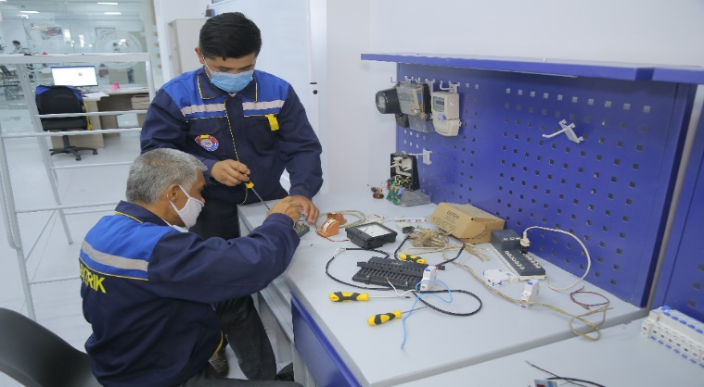
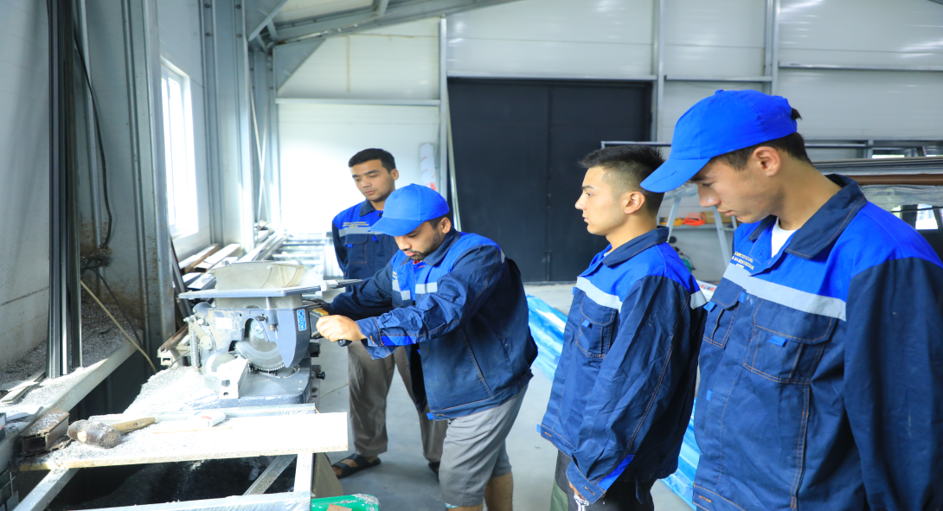
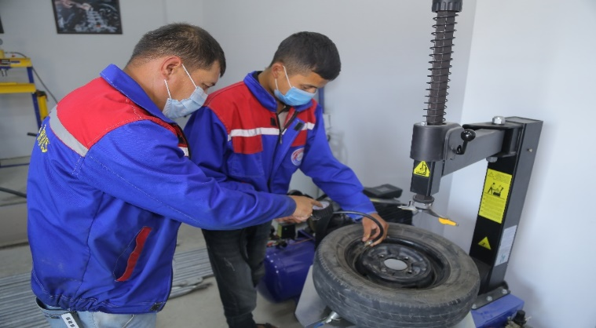
REGIONAL MONOCENTERS "ISHGA MARHAMAT"
Ministry of Employment and Labor Relations of the Republic of Uzbekistan

Slide 8
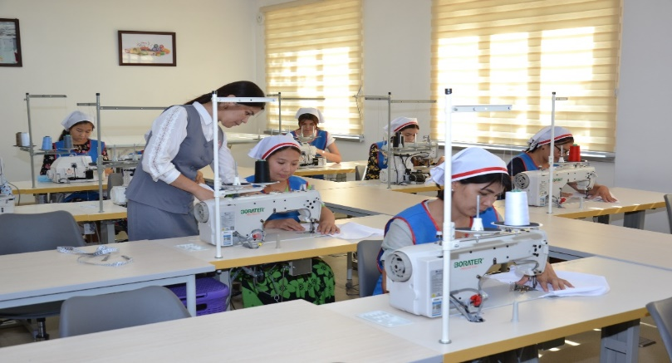
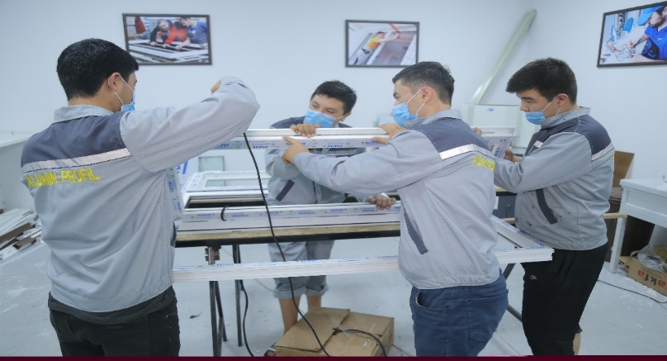
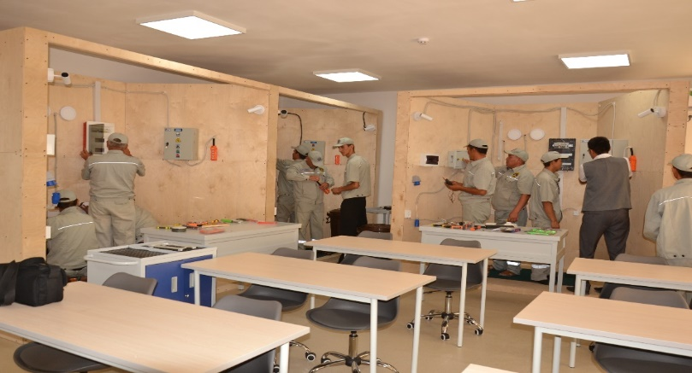
REGIONAL MONOCENTERS "ISHGA MARHAMAT"
Ministry of Employment and Labor Relations of the Republic of Uzbekistan

Slide 9
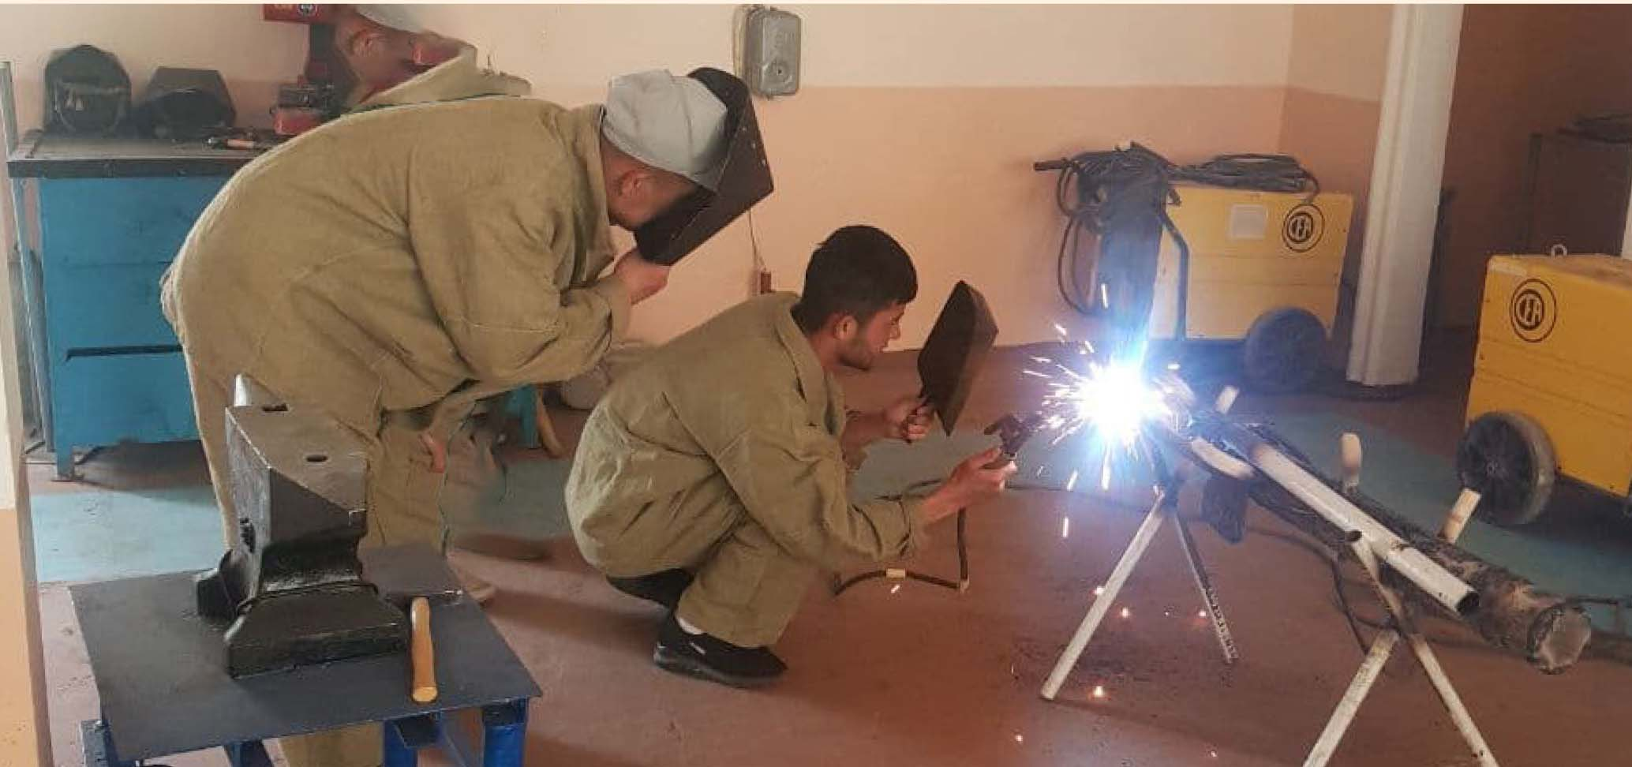
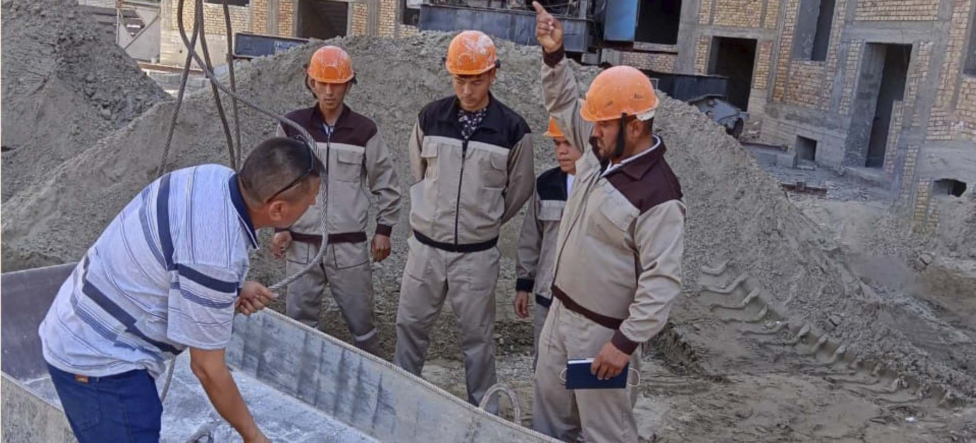
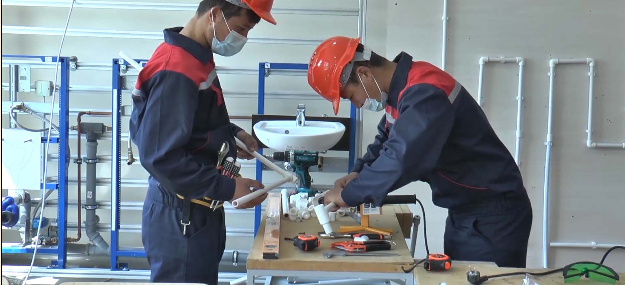
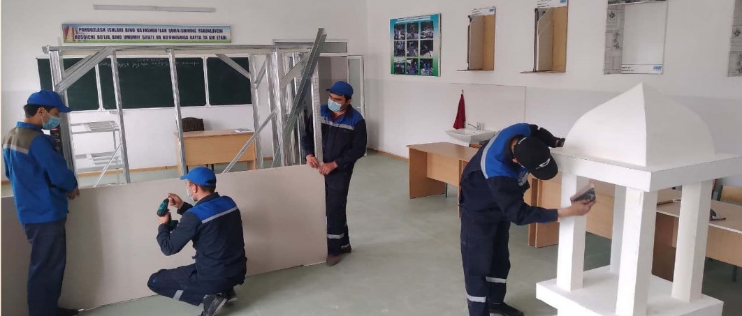
COLLEGES IN THE FIELD OF CONSTRUCTION
Ministry of Employment and Labor Relations of the Republic of Uzbekistan

Slide 10
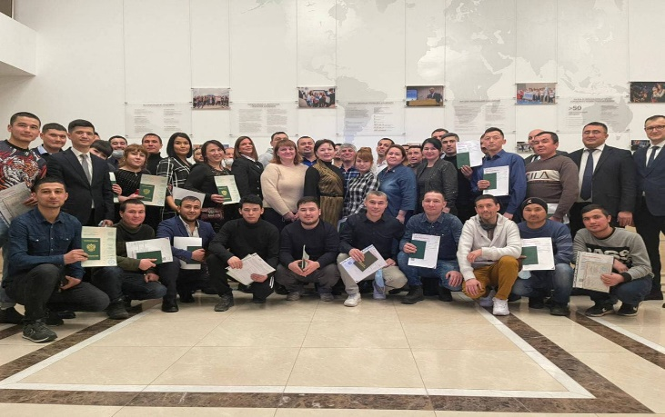
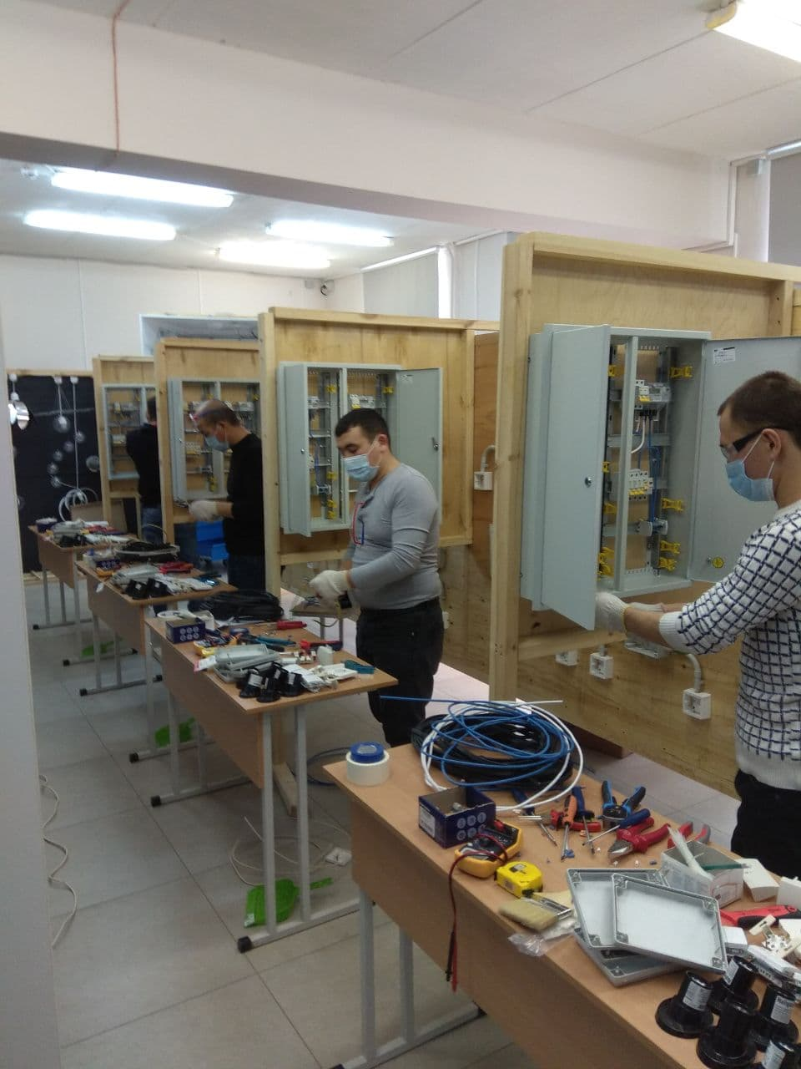
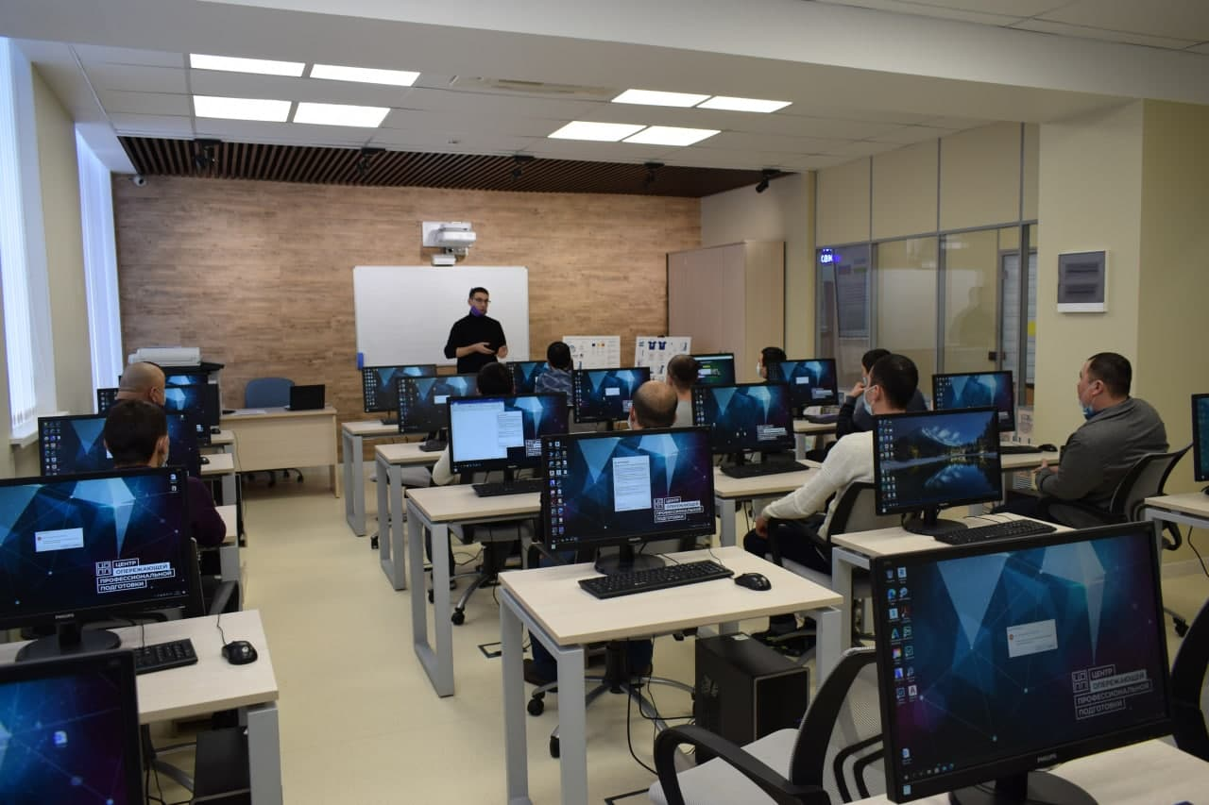
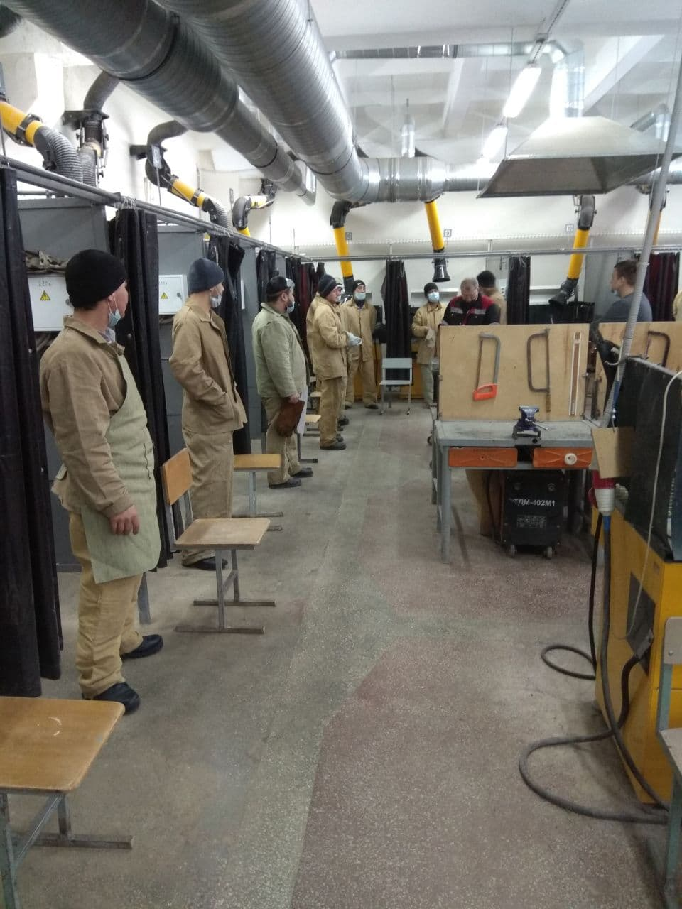
COLLEGES IN THE FIELD OF CONSTRUCTION
Ministry of Employment and Labor Relations of the Republic of Uzbekistan

Slide 11
PROFESSIONAL TRAINING OPPORTUNITIES FOR UNEMPLOYED PERSONS AND IMPLEMENTED MEASURES
Ministry of Employment and Labor Relations of the Republic of Uzbekistan

Slide 12
Cooperation Partnership & Employers
Ministry of Employment and Labor Relations of the Republic of Uzbekistan

Slide 13
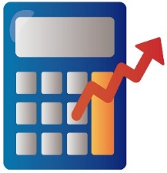
FINANCIAL ASSISTANCE FOR LABOR MIGRANTS
Types of compensation for labor migrants
For passing the qualifying exam in foreign languages or profession
(810 thousand soums ~ 80 USD)
х3
For purchase a ticket
(540 thousand soums ~ 50 USD)
х2
For obtaining a "work visa"
(1 350,0 thousand soums ~ 120 USD )
х5
Ministry of Employment and Labor Relations of the Republic of Uzbekistan

Slide 14
RENDERING LEGAL, SOCIAL AND FINANCIAL ASSISTANCE FOR LABOR MIGRANTS ABROAD
Opening of representative offices abroad of the Agency of External Labour Migration and attaché on labour issues in Diplomatic missions
Representative offices opened in
Russia - 16 (in 16 Regions )
Korea in Gwangju;
Turkey in Istanbul;
Kazakhstan in Chimkent;
Attaché on labour issues:
Russia - 3 (in 3 Regions );
Kazakhstan -3 (in 3 Regions );
The Juridical Center for legal assistance under the Representative office in Moscow
RENDERED Support
2021 year
2022 (3 month)
Consultations
Legal assistance
Social support
Financial support
Return of labor migrants who have fallen into difficult situations abroad
295 102
51 498
8 811
2 167
6 283
2 930
13 424
976
321
229
Ministry of Employment and Labor Relations of the Republic of Uzbekistan

Slide 15
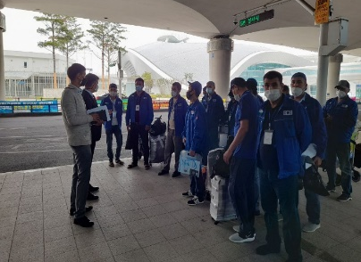
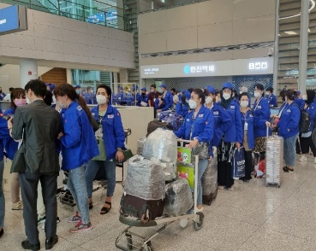
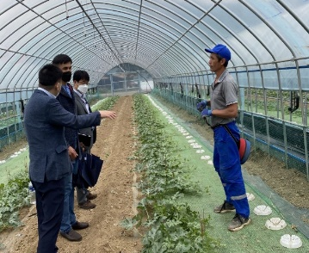
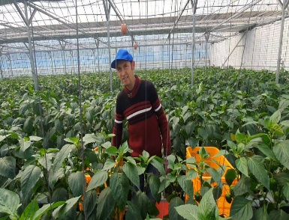
Memorandum of Understanding between the Ministry of Employment and Labor Relations of the Republic of Uzbekistan and the National Pension Service of the Republic of Korea on the application for reimbursement of the national pension (2008)
Memorandum of Understanding between the Ministry of Employment and Labor Relations of the Republic of Uzbekistan and the Ministry of Employment and Labor of the Republic of Korea on sending workers to the Republic of Korea through the Employment Permit System (2016)
Memorandum between the Ministry of Employment and Labor Relations of the Republic of Uzbekistan and the administrations of Yanggu, Inje, Hongchon, Yongyang districts of Korea (2021)

Slide 16
Labor relations between Korea and Uzbekistan
According to the Memorandum of Understanding signed between the Ministry of Employment and Labor Relations of the Republic of Uzbekistan and the Ministry of Employment and Labor of the Republic of Korea from November 2021, citizens of Uzbekistan
The process of attracting work in the production and service sectors on the E-9 visa has resumed.
In that short period of time, 2,000 people who passed the probationary period, including 1,600 people who are going to work for the first time, and 400 people under a re-employment contract with the employer were sent to work in Korea.
In June 2022, it is planned to involve another 650 citizens in organizational work.
Ministry of Employment and Labor Relations of the Republic of Uzbekistan

Slide 17
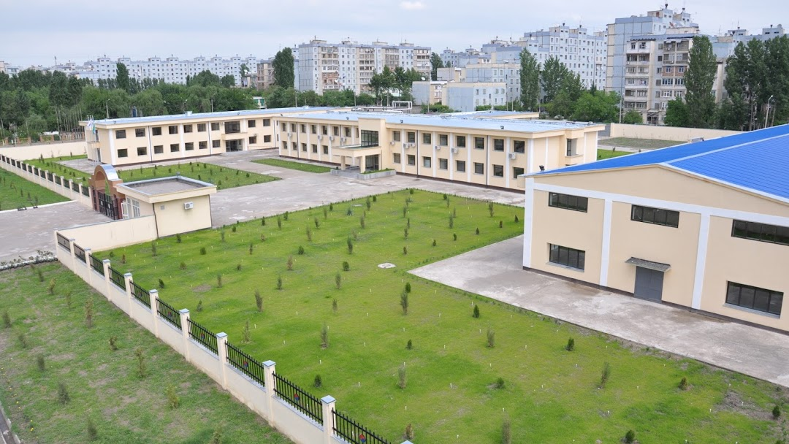
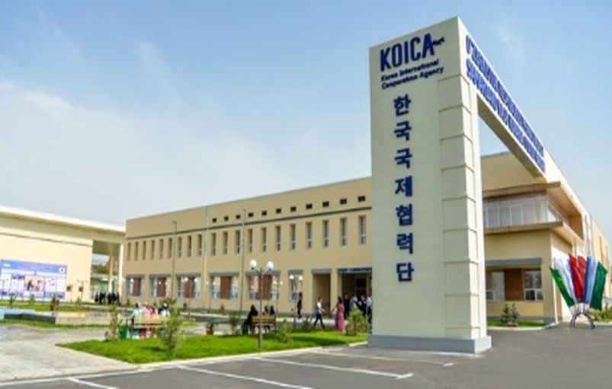
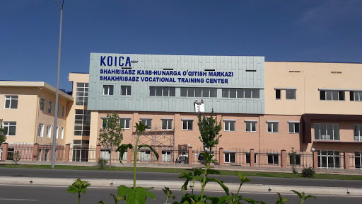
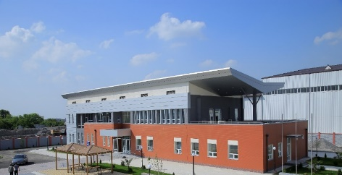
VOCATIONAL TRAINING CENTERS KOICA
Tashkent
Samarkand
Shakhrisabz
Ferghana
Head office of KOICA vocational training centers
2,054 people completed training
1,022 people completed training
$9.8 mln
$3.5 mln
$5.5 mln
$8.5 mln
4,978 people completed training
Employed 91,9%
Employed 95,1%
Capacity 2400 per year
Employed 97%
Repair and maintenance of cars
Welding mechanic
Information Technology
Electronics and Instrumentation
Textile industry
Ministry of Employment and Labor Relations of the Republic of Uzbekistan

Slide 18
REINTEGRATION OF CITIZENS RETURNED TO UZBEKISTAN FROM ABROAD
The number of citizens returned to their homeland from Ukraine
6 030
1 850
Provided with employment, total
36
Retrained for professions
Attracted to entrepreneurship through the allocation of subsidies
48
Women
REINTEGRATION OF CITIZENS RETURNED TO UZBEKISTAN FROM ABROAD in 4 month 2022
Youth
The number of citizens returned to their homeland from abroad
282 330
61 261
Provided with employment, total
176 900
106 712
4 161
Trained&Retrained for professions
Attracted to entrepreneurship through the allocation of subsidies
131
Ministry of Employment and Labor Relations of the Republic of Uzbekistan

Slide 19
FUTURE PROJECTS FOR DEVELOPING REINTEGRATION PROGRAM IN 2022
ESTABLISHING REINTEGRATION CENTERS
BENEFITS AND PROGRAMS
Invests projects
Main Functions:
identifies the needs of migrant workers and their families and takes appropriate measures with the relevant authority bodies;
organizing competitions for young labor migrants and involve them in grant projects "First Step to Business“;
provides socio-legal, psychological and material assistance , vocational training, involvement in entrepreneurial activities for women;
providing vocational training, employment, entrepreneurship and self-employment activities for youth.
providing subsidies in the amount of 50% of the cost of labor migrant business projects;
480 billion soums will be allocated to ensure employment of 50,000 returned labor migrants;
providing free vocational training with covering the costs of qualification assessment of returned labor migrants.
providing loans and subsidies for labour migrants for their each project;
subsidies are allocated to graduates to purchase equipment for starting a business;
Free allocate buildings and land plots for labour migrants, which have been set aside in small industrial zones.
Ministry of Employment and Labor Relations of the Republic of Uzbekistan

