Slide 1
Strengthening Regional Cooperation on Skills Development under the CAREC Program: Key Progress, Challenges, and Opportunities for Collaboration Inception Meeting and International Expert Roundtable 30–31 May 2022, Tbilisi, Georgia
Networks and Associations for the HE sector:
The European example
Elizabeth Colucci Advisor for Internationalisation European University Association

Slide 2
Relative Taxonomy for the EU context
Associations:
Legally established/ clear membership basis
Defining statutes/governance structure
Policy orientation
Ex. EUA, EURASHE, ESU
Networks
Can be lighter
Thematically/mission or geographically defined – institutions or academics/individuals
Some project-defined/some longstanding
Often fewer members than associations
Practically oriented as opposed to politically oriented
Ex. Coimbra Group, Santander Group, LERU
University Alliances
Newer development: European University Alliances (EU funded/ response to European Education Area)
Holistic/sustainable institutional alliances based on common mission
Consortia for joint degrees, joint teaching, integrated/ strategic mobility, joint research etc.
Notes:
Association, such as EUA is one, as legally established bodies, with a clear membership basis, and managed by a secretariat.
University networks – usually a bit lighter, and dynamic in their coming into existence, gathering around a certain thematic purpose, and/or geographic focus. Not easy to find to draw a clear line between association and networks.
In addition, there are university partnerships and alliances, some of which are ad-hoc, of limited duration and purpose (often for project implementation), but some are also longstanding, thematically holistic. They may involve anything with 2 or more members (but usually stay under 10)
A special case in this regards are the recent European University Alliances, which have been launched with E+ and HEU funding to establish sustainable alliances between universities across Europe.

Slide 3
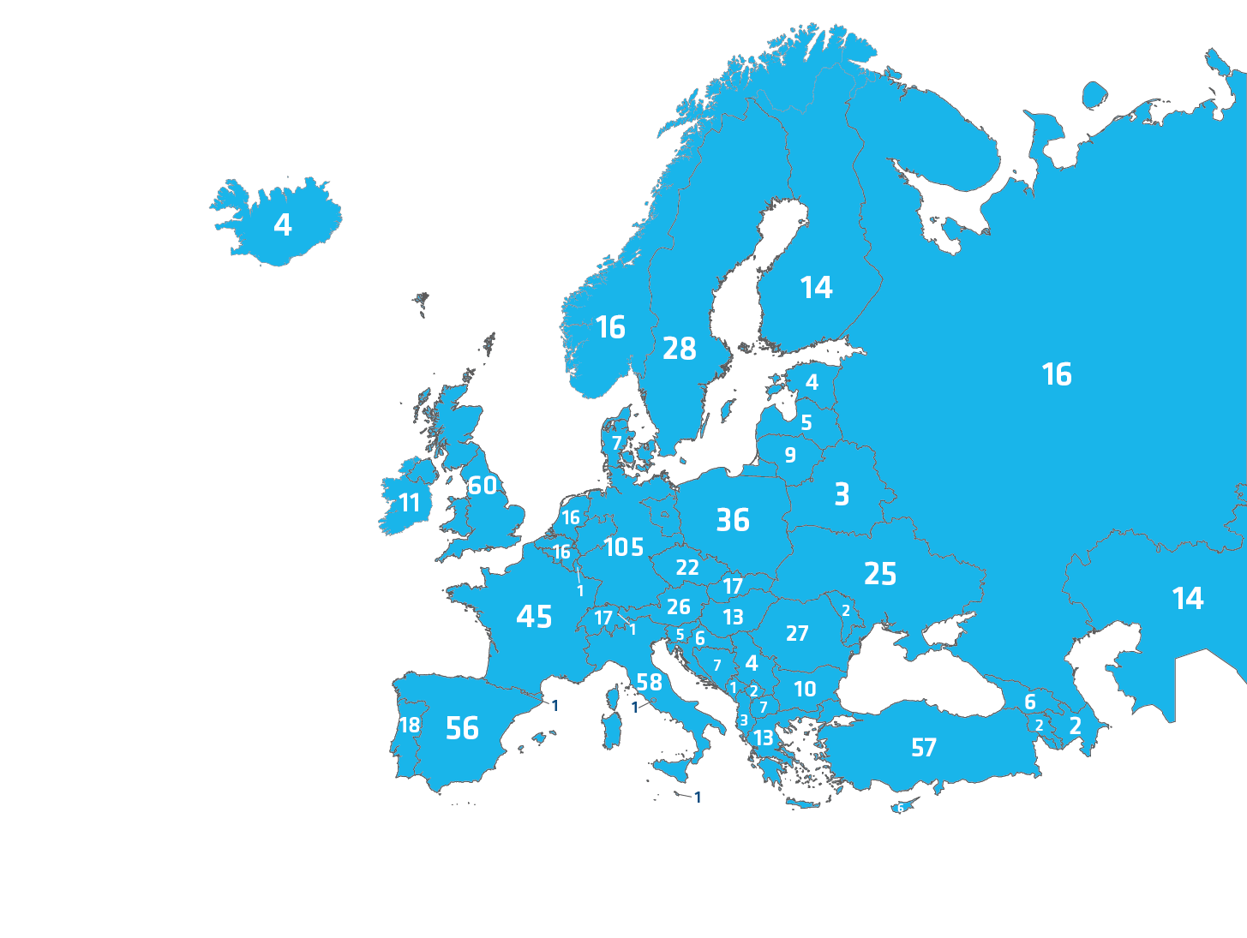
European University Association (EUA)
850 members (HEI and national university associations – diversity of size and mission)
Independent voice of the European university sector
Merger of previous association of rectors conferences and pan-European university association: Two-tiered governance
Forum for exchange, peer learning of members (collaborative projects, forums)
Policy making/lobbying: EU and the wider Europe – Bologna Process
International dialogue & cooperation with university associations around the world
Notes:
Kazakh full members:
Al-Farabi Kazakh National University
Nazarbayev University
10 associate members
Individual associate members are higher education institutions that award degrees at the first and second cycle level, but do not meet the research criteria as set for full individual members. They have access to all membership services and conferences; however, they do not have the right to vote in EUA's General Assembly or to hold elective office.
Teaching and learning forum, funding forum, QA forum

Slide 4
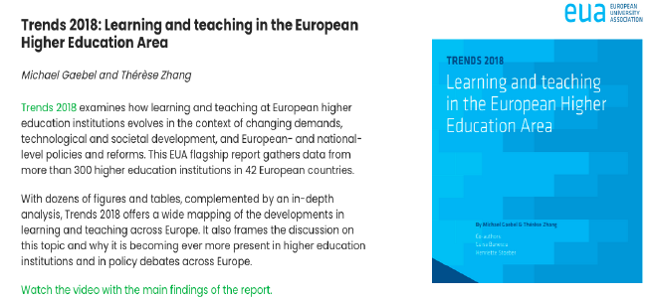
Policy input: Voice of the European university sector towards Bologna

Slide 5
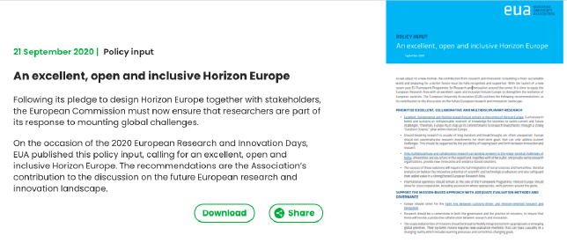
Policy input: The European Research Area

Slide 6
EU funded initiative to support a network of Higher Education Reform Experts in all neighborhood countries, including Central Asia
Agents for policy reform: represent rectors, ministry, QA agency students, academics…. Strategically selected
Centralised training activities, teachnical assistance
Direct line to Bologna/Bologna like reforms
Revolve around National Erasmus+ Office and linked to EU projects/impact/policy assessment
EUA and the nieghborhood:
SPHERE

Slide 7
1-2 seminars per year
Thematically focused
2-3 study visits per year
To an institution/city/country: case focused/ ‘hands on’
Technical Assistance Missions (TAM) (approx 55/year)
Targeted county assistance
Expert provided for national support/national activity
Annual conference
Bridging event/ linking key themes/ larger-scale networking
3 major publications:
Ex:) Structural Impact of Erasmus+ Capacity Building Projects on Higher Education Systems in Partner Countries (2021) : https://supporthere.org/sites/default/files/sphere_1.pdf
Website and Virtual Community: www.supporthere.org
SPHERE Activities:
2015 - 2021

Slide 8
EUA value-add/ success
Comprehensive sectoral voice: Represents diversity of universities in EHEA/finds common positions towards Brussels/Bologna
Structural legitimacy: Governance predicated on national university associations and universities
Serves multiple spaces: EU versus EHEA
Maturation intertwined with Bologna/EHEA – have grown together
Strong advocate of strengthening institutions (strategy development, structural supports to teaching, learning, research)
Notes:
Association, such as EUA is one, as legally established bodies, with a clear membership basis, and managed by a secretariat.
University networks – usually a bit lighter, and dynamic in their coming into existence, gathering around a certain thematic purpose, and/or geographic focus. Not easy to find to draw a clear line between association and networks.
In addition, there are university partnerships and alliances, some of which are ad-hoc, of limited duration and purpose (often for project implementation), but some are also longstanding, thematically holistic. They may involve anything with 2 or more members (but usually stay under 10)
A special case in this regards are the recent European University Alliances, which have been launched with E+ and HEU funding to establish sustainable alliances between universities across Europe.

Slide 9
Network ex.: Coimbra Group
41 members
“long-established European comprehensive, multidisciplinary universities of high international standard committed to creating special academic and cultural ties in order to promote, for the benefits of its members, internationalisation, academic collaboration, excellence in learning and research, and service to society”
Working groups:
Research (life sciences, humanities, science/technology)
Education (mobility, doctoral studies, education innovation)
Outreach
Seminars, benchmarking, scholarships, summer schools

Slide 10
From networks to European University Alliances
European Universities Initiative: https://ec.europa.eu/education/education-in-the-eu/european-education-area/european-universities-initiative_en

Slide 11
Recommendations for CAREC
Strengthen and connect national HEI associations
Autonomy (financial, political)
Capacity to incentivise reform and monitor trends in the HE sector
Concretise/formalise their role in the regional integration space and processes
Independent yet consistent partners of the ministries
Clarify the differentiated missions of networks and their potential complementarity
Consider the ‘Alliance’ model as a means to incentivise groupings of HEI across CAREC to formalise and deepen strategic relationships in-line with the goals of the regional skills agenda
Notes:
EUA not subsidised by the EU – independent – fees and project funding
EUA role in the BFUG

