Slide 1
Strengthening Regional Cooperation on Skills Development under the CAREC Program: Key Progress, Challenges, and Opportunities for Collaboration Inception Meeting and International Expert Roundtable 30–31 May 2022, Tbilisi, Georgia Frontiers for Reform: Creating and Sustaining University and TVET Networks
Creating and Sustaining University and TVET Networks
ALIAS ABU BAKAR
Centre Director
SEAMEO VOCTECH Regional Centre

Slide 2
Contents
1
2
3
4
Purpose and types of University and TVET Networks
Existing Networks
Lessons Learnt
Way Forward
Creating and Sustaining University and TVET Networks
Notes:
right

Slide 3
Purpose of Creating University and TVET Networks for Skills Development
Respond to the changing skills needs for future world of work.
Demand for advanced cognitive and socio-behavioral skills, and skills combinations associated for greater adaptability is also rising (World Bank, 2019).
TVET and universities, as key players in developing human resources, are necessary to take strategic decisions and create linkages to address the emerging labor market by enabling students to survive in VUCA (Volatility, Uncertainty, complexity and ambiguity) world.
Creating and Sustaining University and TVET Networks

Slide 4
UNESCO
UNESCO (2016) appeals that:
“Member States should develop pathways and facilitate transitions between secondary, post-secondary and tertiary education including flexible admission procedures and guidance, credit accumulation and transfer, bridging programs and equivalency schemes that are recognised and accredited by relevant authorities. TVET institutions, and other education institutions and authorities, should collaborate for the implementation of such measures.”
Creating and Sustaining University and TVET Networks

Slide 5
“TVET needs to be more attractive to the students and demonstrate capacity to enable progression towards higher vocational and academic education.” The European Commission (2016)
“Flexible pathways and progression of TVET learners to the higher levels of education was recognised to be critical”. (UNESCO, 2012, the Third International Congress on TVET in Shanghai in 2012).
Creating and Sustaining University and TVET Networks

Slide 6
Types of University and TVET Networks
Network amongst applied universities
Network amongst TVET institutions
Articulation between TVET and university network
Creating and Sustaining University and TVET Networks

Slide 7
Articulation between TVET and University Network
Providing articulation opportunities for students who are willing to avail university degree that is required for further advancement in their career. In areas such as teaching, professional skill development, research and development, consultancy and promotion as well as marketing (Sommerlad et al., 1998)
Restricted entries
Open door policies
Creating and Sustaining University and TVET Networks

Slide 8
Examples
Germany, Belgium, Spain, and France, the link between vocational education and higher level education is stronger, ensuring flexible pathways (OECD 2012).
Norway and Spain, it takes the form of hybrid programs that offer TVET and academic programs in an integrated manner (Souto-Otero, and Ure, 2012)
In the Czech Republic, TVET provision is based on an open door policy, providing greater transition opportunity and pathway from TVET to higher education (Kaňáková et al., 2016)
In Australia, the dual-sector universities provide integrated technical and further education (TAFE), while the university level programs are carried out in partnership with each other.
Creating and Sustaining University and TVET Networks

Slide 9
Existing Regional TVET Networks in Southeast Asia
SEA-TVET Consortium (2015):
Offering opportunity for collaboration, including students and staff exchange among TVET institutions, at secondary and postsecondary, in ASEAN + China and Japan; Registered Institutions: 2163
Website: https://seatvet.seameo.org
The ASEAN-ROK TVET Mobility Programme (2022):
It addresses (1) quality assurance; (2) qualification standards; (3) capacity building of TVET personnel; and (4) intra-ASEAN student mobility through internships and faculty exchange.
It’s still in a development state.
Regional Association on Vocational Teacher Education (RAVTE):
Supports personnel development in order to enhance TVET quality and efficiency as well as fostering the ongoing integration activities and developments in East and Southeast Asian countries.
Website: http://www.ravte-asia.rmutt.ac.th
Creating and Sustaining University and TVET Networks

Slide 10
Existing Regional HE Networks in Southeast Asia
ASEAN University Network (AUN):
Offering cooperation among universities in ASEAN by promoting collaborative studies and research programs on the priority areas identified by ASEAN.
Website: https://www.aunsec.org
The Asian International Mobility for Students (AIMS) Programme under SEAMEO-RIHED:
Supports the mobility of students and enhance cooperation in higher education among countries in Asia.
Website: https://aims-rihed.net
Creating and Sustaining University and TVET Networks

Slide 11
Lessons Learnt from Creating and Sustaining the Networks
Limited networks that link TVET and HE.
Importance of articulations between TVET and HE to assure continuity and to encourage/incentivise TVET enrollment.
The need of curriculum mapping for horizontal exchange.
Sustainability of collaborations through awareness and assurance of benefits of all network members
Creating and Sustaining University and TVET Networks

Slide 12
Way Forward
Synergise the existing networks
Assess the effectiveness of existing networks and enhance them according to current requirements
Socialise and utilise the current networks and expand their members
Create new networks, if necessary, that link and articulate collaboration between TVET and HE institutions at the national, regional, and global level.
Creating and Sustaining University and TVET Networks

Slide 13
Theme: “Working Together towards Harmonisation and Internationalisation of TVET in Southeast Asia”.
The establishment of the “SEA-TVET Consortium” was established by SEAMEO in 2015, to achieve the following goals.
To leverage the standard and competency of TVET in Southeast Asia through internationalisation and harmonisation;
To promote and develop the curriculum harmonisation, and internationalisation of study programmes through lecturer/student exchange, joint research programmes and industrial linkages; and
To create a sustainable networking platform among TVET leaders and institutions in Southeast Asia and industry and other related development agencies and industry sectors.
Creating and Sustaining University and TVET Networks

Slide 14
Priority Study Areas Following are the priority study areas of the consortium.
Hospitality and tourism
Agriculture, fisheries
Electronic, Mechatronics and Manufacturing
Construction
Commerce
More Areas
So far, 2,164 institutions have registered to be members
Creating and Sustaining University and TVET Networks

Slide 15
Main Activites
The main activities under SEA-TVET consortium are :
Students Exchange
Staff Exchange
Industrial Attachment
Sharing Expertise and Resources
Research Collaboration
Students’ exchange will be performed by TVET institutions.
The number and the duration will be decided by participating schools, colleges, and polytechnics.
Ideally, the minimum duration for students’ exchange is 1 month to 3 months or one year.
The details of implementing student exchange, such as harmonising curriculum for possible matriculation and recognition, arranging the student travel, and prepare pre-departure programme.
Creating and Sustaining University and TVET Networks

Slide 16
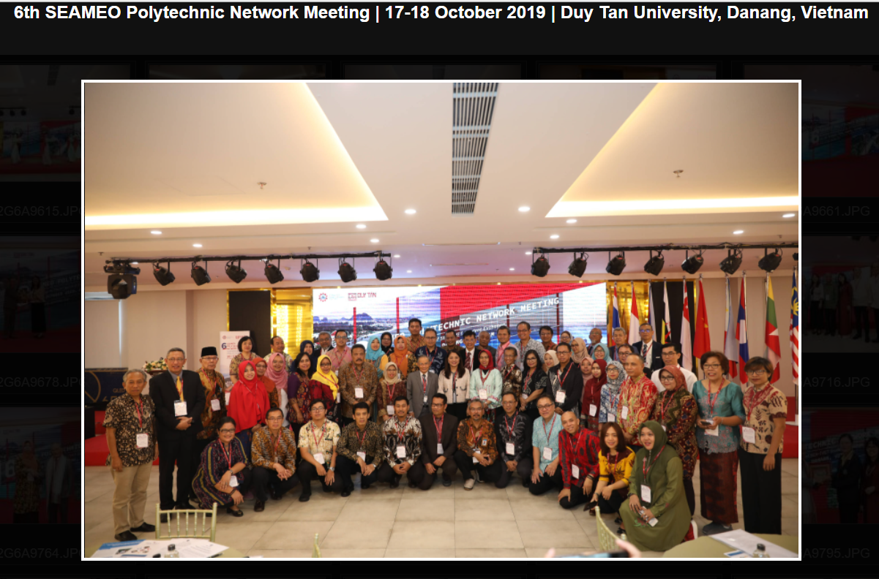
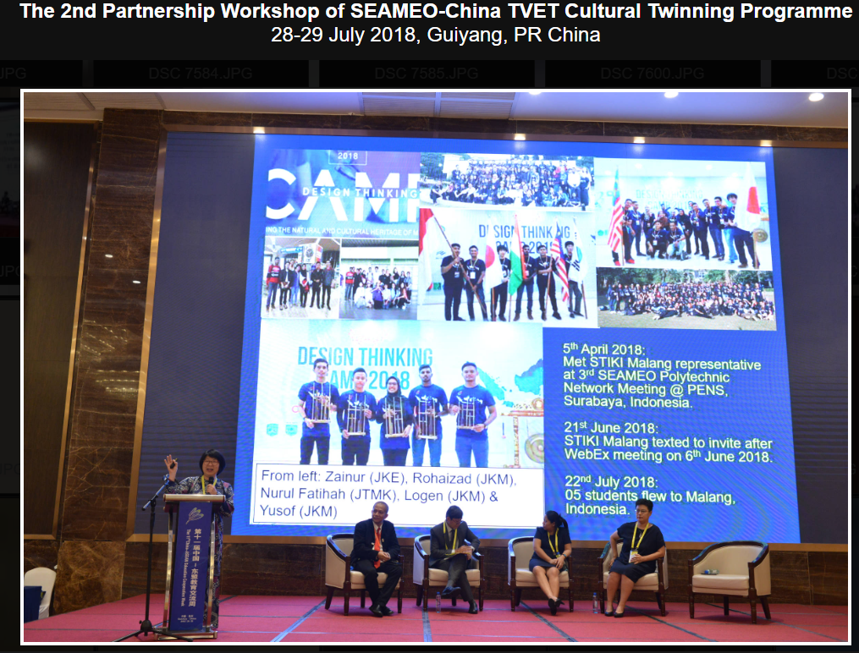
Creating and Sustaining University and TVET Networks

Slide 17
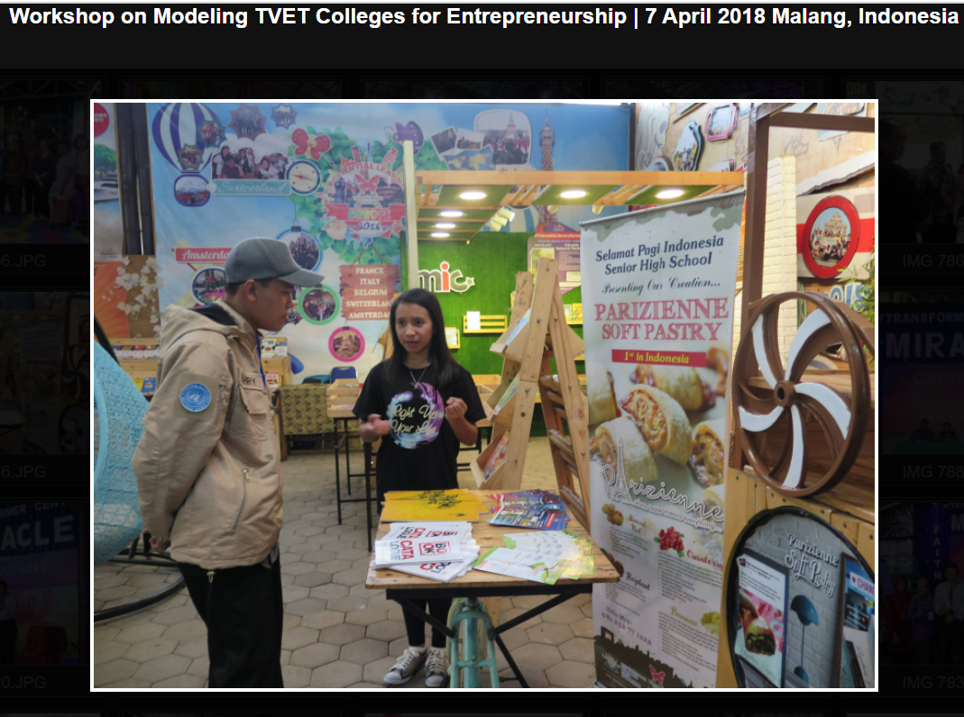
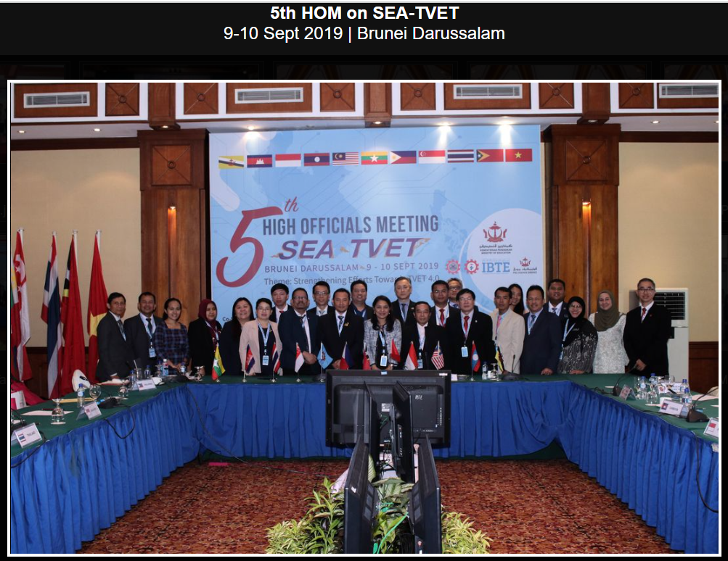
Creating and Sustaining University and TVET Networks

Slide 18
Thank you
Creating and Sustaining University and TVET Networks

