Slide 1
Strengthening Regional Cooperation on Skills Development under the CAREC Program: Key Progress, Challenges, and Opportunities for Collaboration Inception Meeting and International Expert Roundtable 30–31 May 2022, Tbilisi, Georgia
The Role of University-TVET-Industry Linkages in Promoting Skills Development
Brajesh Panth Chief of Education Sector Group Asian Development Bank
Meekyung Shin Education Specialist Asian Development Bank

Slide 2
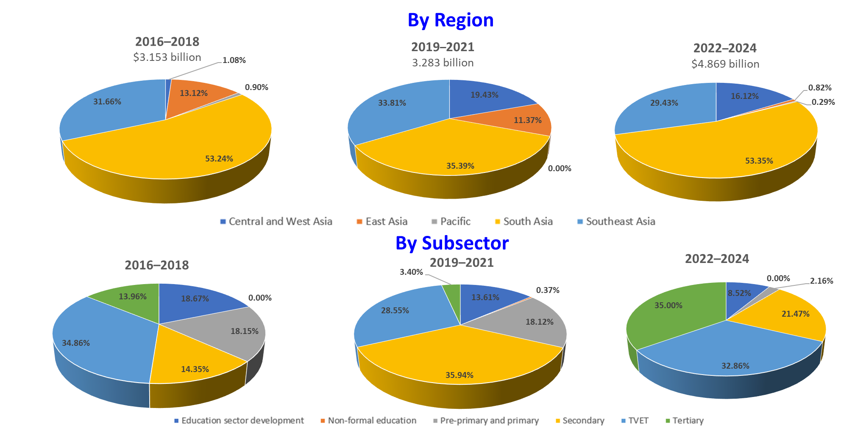
ADB’s Education Portfolio

Slide 3
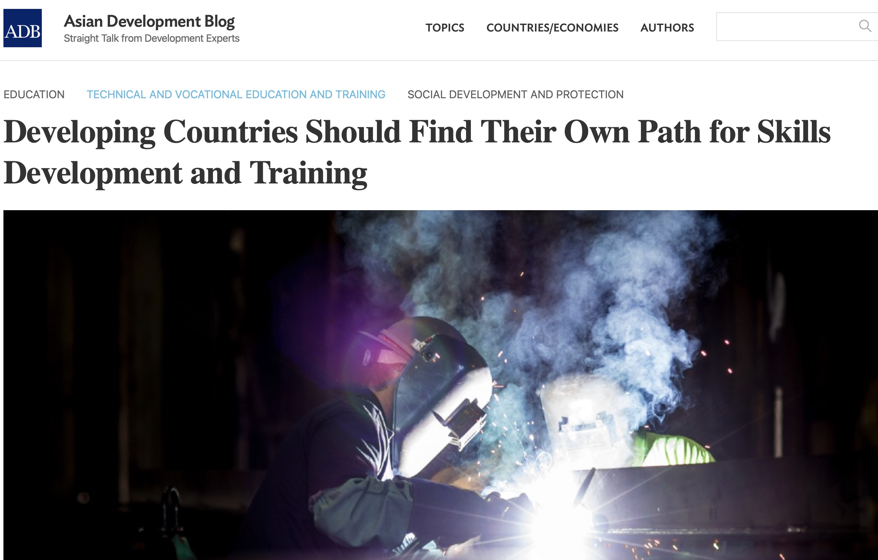
Role of Higher Education—TVET Network
Educated and skilled human resources are the backbone of knowledge-driven economies.
University­–Industry linkages (UIL) are strategic vehicles to support industry including SMEs and entrepreneurship to help create quality jobs.
Creating a network of advanced universities to support developing universities in ADB’s DMCs can promote and support regional cooperation and mutual recognition.

Slide 4
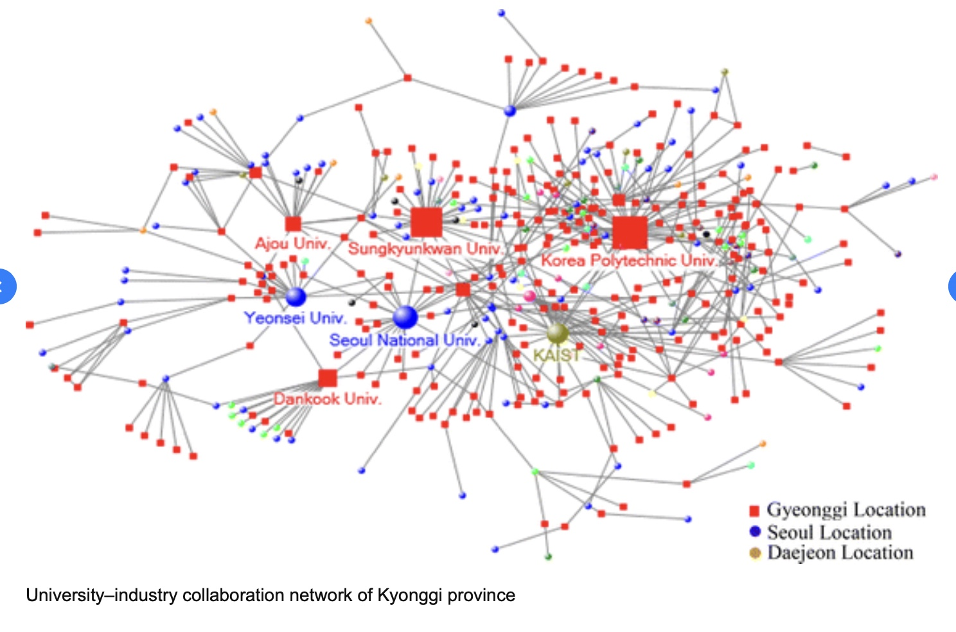
PRC: Hunan’s Networked Training Model
UIL is a central part of PRC’s TVET policies; Hunan government is the policy entrepreneur for UIL.
The policies contribute to the emergence and growth of local skill-ecosystem in strategically important industries.
Hunan’s 70 vocational colleges have developed the Networked Training Model (NTM).
NTM forges whole-of-government collaboration between colleges, enterprises, and research organizations.
* The NTM integrates a firm’s in-house, work-based training with school-based learning in classrooms.
Hunan’s experience is relevant to other DMCs for upgrading manufacturing and service industries to a higher value chain.
ADB TA : Technical and Vocational Education and Training Management Capacity Building in Hunan
Source : ResearchGate.

Slide 5
The Case for Collaboration between Higher Education and TVET
Advanced Knowledge and Skills for Sustainable Growth Project (Indonesia)
ADB to Enhance Advanced Skills Developments and
Upgrade Higher Education Quality in Indonesia
HE can produce better teachers to meet growing demand for TVET.
To expand the current small pool of senior secondary vocational education (SMK ) teachers with the required qualifications.
Indonesia University of Education is being strengthened to provide high quality TVET teachers in areas such as information systems and technology; artificial intelligence and robotics; industrial instrumentation engineering; and renewable energy engineering.

Slide 6
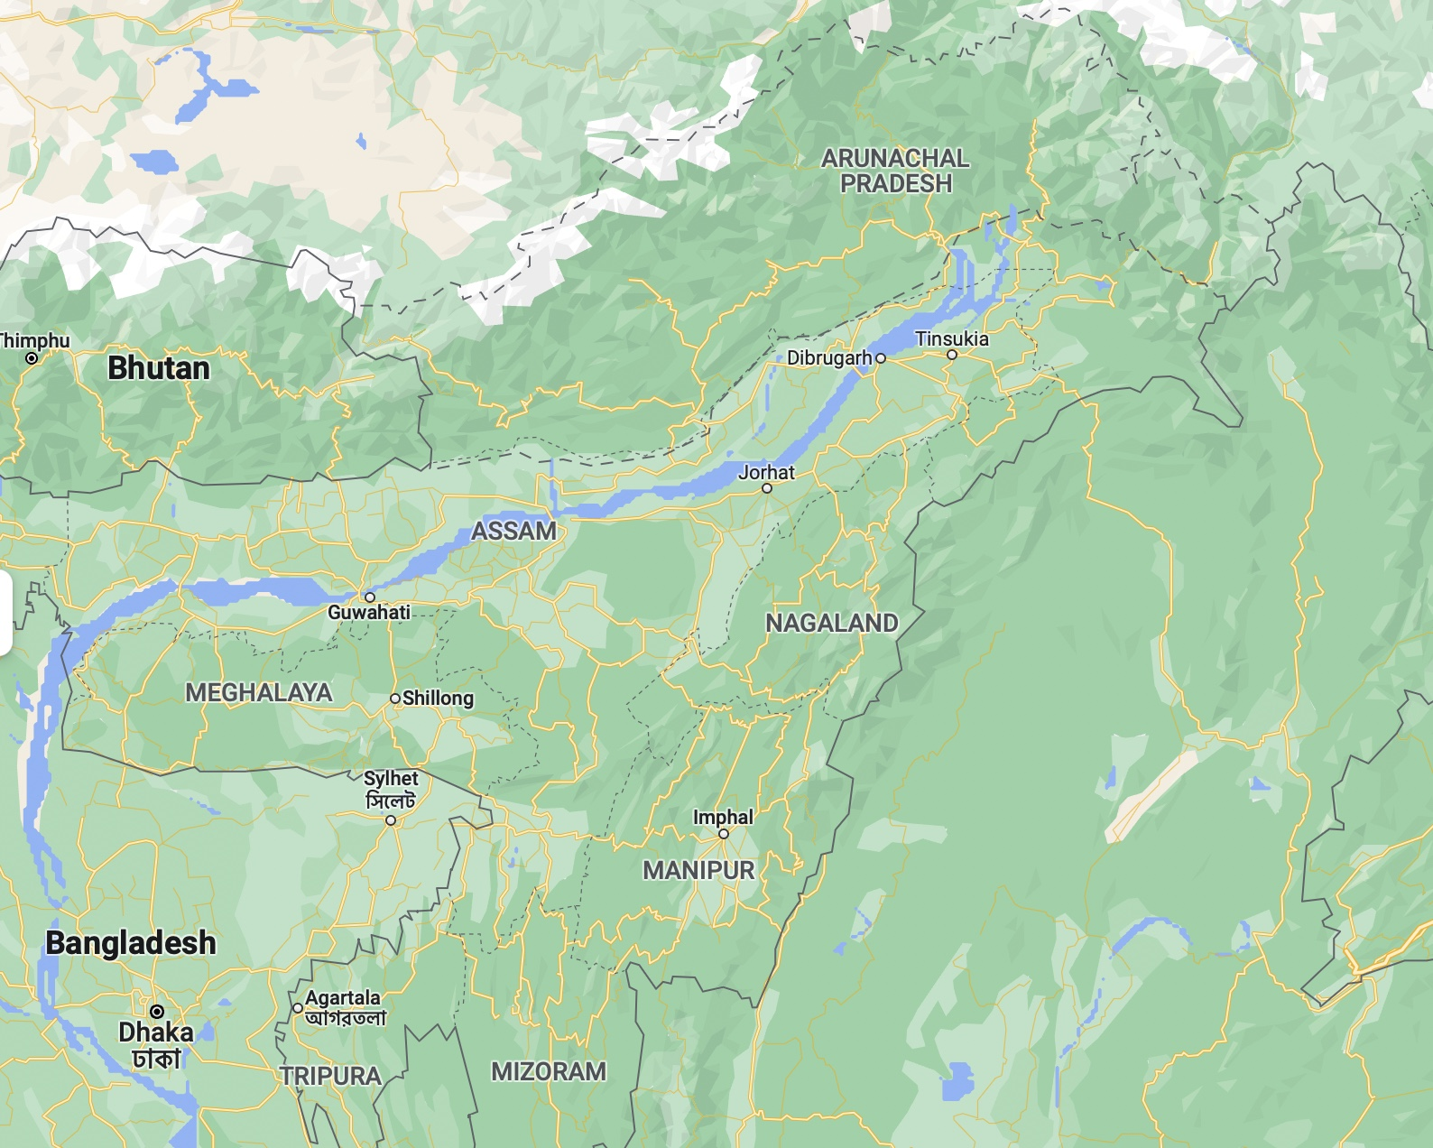
Promoting Mobility between University and TVET
TVET and HE systems in Assam (India) lack pathways for progression and mobility.
In Assam, 23 polytechnics offer diploma courses, 46 engineering colleges offer engineering degree programs, but the uptake is minimal due to lack of pathways.
Industrial Training Institutes and Polytechnics are less attractive due to limited opportunities for upskilling and further study. Academic institutions have limited opportunities for skills development for employment.
ADB’s support to Assam Skill University will create pathways for skills progression and mobility and raise skills levels to enhance productivity and competitiveness of Assam’s economy and industries.

Slide 7
Mutual Recognition in HE and TVET
The Global Convention* facilitates the recognition of qualifications, prior learning and study periods earned remotely.
* Nov 2019, the Global Convention on the Recognition of Qualifications concerning Higher Education was adopted, becoming the first United Nations treaty on HE with a global scope.
The regional network between HE and TVET has a huge potential in facilitating mobility between HE and TVET, and to standardize and harmonize qualifications between different institutions.
EdSG at ADB is exploring to establish a collaboration platform to expand HE partnerships and network.
Advance expertise and innovation in priority areas like climate change, digital technology, health and education.
Facilitate the mobility of students and faculty, and promote mutual recognition.

Slide 8
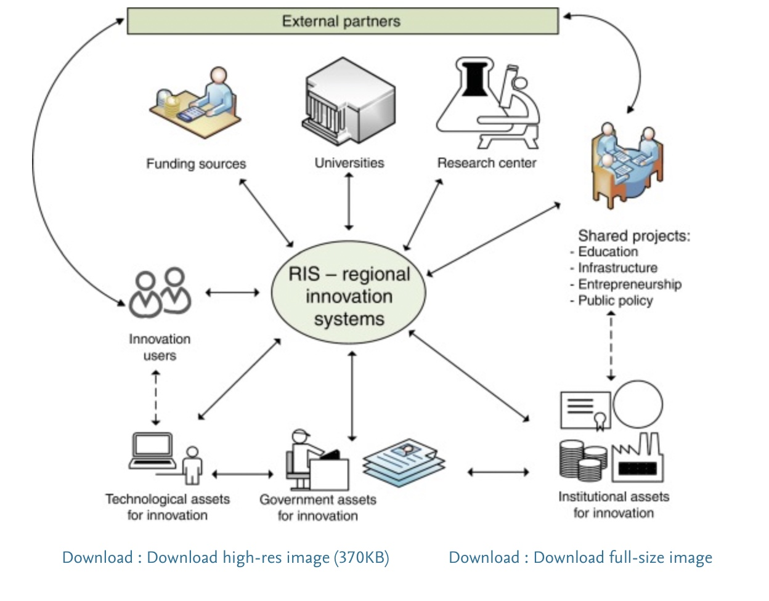
More Collaboration between Higher Education and TVET
Studies
Cooperation on student career guidance and pathways
Joint degree programs and further training
Research
Joint research project
Joint support for young researchers
Administration
Pooling of IT systems, management, maintenance
Pooling of services (procurement, construction, facility management, library)
Knowledge transfer
Regional alliance and shared knowledge platform
Shared industry cooperation
Source: Science Direct.

Slide 9
Thank you!
@ADB Education
@ADBEducation
www.adb.org/what-we-do/sectors/education

