Slide 1
Strengthening Regional Cooperation on Skills Development under the CAREC Program: Key Progress, Challenges, and Opportunities for Collaboration Inception Meeting and International Expert Roundtable 30–31 May 2022, Tbilisi, Georgia
Skills Development in the CAREC Region: Reinforcing Convergence to Meet Regional and Global Standards
Dovelyn Rannveig Mendoza Resource Person Asian Development Bank

Slide 2
Presentation Outline
1
2
4
Convergence in governance structures: legal and institutional reforms
Policy convergence towards international standards: four levels of collaboration
3
Remaining challenges: funding, building and maintaining effective skills development systems
Moving forward: Reinforcing Convergence and Making a case for an integrated approach on skills development

Slide 3
Section 1: Convergence in governance structures: legal and institutional reforms in Three Areas

Slide 4
legal and institutional reforms in Three Areas
1. Setting of foundational laws and decrees
2. Centralizing governance structures
3. Increasing Diversity in Types of Training Institutions and Programs

Slide 5
Afghanistan
Law on Civil Higher Education (2015)
Education Law (2008)
Constitution of Afghanistan (2004)
Draft TVET Law (2020)
Azerbaijan
Law on Education (2009)
China
Private Education Promotion Law (2002)
Higher Education Law (1998)
Vocational Education Law (1996)
Georgia
Law on Development of Quality of Education (2010)
Law on General Education (2005)
Law on Higher Education (2004) (Higher Education perspectives in Georgia and integration to the EHEA
Law on Vocational Education (2018)
Law on Special Vocational Education and Training (2011)
Kazakhstan
Law on Education (1992-2018)
Education Law/no. 319-III ZRK (2021)
Kyrgyz Republic
Decree on Strategic Directions of Development of the Education System (2012)
Decree on two-cycle system of higher education (2011)
Law on Education (last amended in 2019) (1992)
Mongolia
Higher Education Master Plan 2006-2015 (2006)
Law on Education, No. 19 (amended in 2008) (2002)
Education Law (1995)
Education Law (1991) (established the legal basis for private universities and institutions)
Law on Vocational Training and Education 2009
Pakistan
Higher Education Commission Ordinance (2002)
The Apprenticeship Act 2018
National Vocational and Technical Training Commission Act 2011
Tajikistan
Law No. 1004 Ministry of Education of 22 July 2013 on Education (2013)
Law No. 531 of 19 May on Higher Education (2009)
Law of No. 1761/Training of Specialists Taking into Account Requirements of the Labor Market
Drafted Law on Initial Vocational Education and Training 2020
Law No. 1394 of on "Adult Education", as amended to 2 January 2018
The Law on Promoting Employment 2003
Turkmenistan
No. 391-IV on Education (2013) (regulates higher and vocational education and lays out Bachelor’s, Master’s and Specialist degrees.
Uzbekistan
Law on Education (1997)
National Programme on Personnel Training (1992)
Act No. 61/1998 to amend and supplement the Act on Employment of the Population, amended in 2014
Ordinance No. 242 2012
Act No. 464-I on Education (Text No. 225) 1997)
Laws and Decrees on Higher Education and TVET in the CAREC REGION
Source: International Association of Universities. “World Higher Education Database.” Paris, 2021; https://www.whed.net/home.php and UNESCO-UNEVOC International Centre. “UNESCO-UNEVOC TVET Country Profiles Database.” Bonn, 2022. https://unevoc.unesco.org/home/TVET+Country+Profiles.

Slide 6
legal and institutional reforms in Three Areas
1. Setting of foundational laws and decrees
2. Centralizing governance structures
3. Increasing Diversity in Types of Training Institutions and Programs

Slide 7
Governing Bodies Responsible for Higher Education and TVET in the CAREC Region
Country | Under one ministerial-level body | Under separate ministerial-level body bodies | Name of Responsible Bodies
Afghanistan | TBC | TBC | TBC
Azerbaijan | X |  | Ministry of Education
China |  | X | Ministry of Education Ministry of Human Resources and Social Security
Georgia | X |  | Ministry of Education and Sciences
Kazakhstan | X |  | Ministry of Education and Sciences
Kyrgyz Republic | X |  | Ministry of Education and Sciences
Mongolia |  | X | Ministry of Education and Sciences Ministry of Labour and Social Protection
Pakistan | X |  | Federal Ministry of Education
Tajikistan |  |  | Ministry of Education and Sciences
Turkmenistan | X |  | Ministry of Education
Uzbekistan |  | X | Ministry of Employment and Labor Relations Ministry of Higher and Secondary Specialised Education
Sources: Author’s analysis based on the UNESCO-UNEVOC International Centre. “UNESCO-UNEVOC TVET Country Profiles Database.” Bonn, 2022. https://unevoc.unesco.org/home/TVET+Country+Profiles; and the International Association of Universities. “World Higher Education Database.” Paris, 2021. https://www.whed.net/home.php.

Slide 8
legal and institutional reforms in Three Areas
1. Setting of foundational laws and decrees
2. Centralizing governance structures
3. Increasing Diversity in Types of Training Institutions and Programs

Slide 9
Types of Higher Education Institutions in the CAREC Region
Country | University |  |  |  | Academy | Institute |  | Conservatory | College
 | Regular | Research | Teaching | Open |  | Regular | Research |  | Regular | Junior | Independent | Vocational
Afghanistan | X |  |  |  |  | X
Azerbaijan | X |  |  |  | X | X |  | X
China | X |  |  | X |  |  | X |  | X | X | X | X
Georgia |  | X | X |  |  |  |  |  | X
Kazakhstan |  | X | X |  | X | X
Kyrgyz Republic | X |  |  |  | X | X |  | X
Mongolia |  | X |  |  |  |  | X |  | X
Pakistan | X |  |  |  |  |  |  |  | X
Tajikistan | X |  |  |  | X | X
Turkmenistan | X |  |  |  | X | X |  | X
Uzbekistan | X |  |  |  | X | X
Source: Author’s analysis based on the International Association of Universities. “World Higher Education Database.” Paris, 2021. https://www.whed.net/home.php.

Slide 10
Section 2. Policy Convergence Towards International Standards: Four Levels of Collaboration

Slide 11
Policy Convergence Towards International Standards:
Four Levels of Collaboration
Dialogue
Accommodation
Knowledge transfer
information-sharing and networking
no pressure to agree or to arrive at a formal conclusion, or to engage in concrete action
entails concrete action
the partners "accomodate" each other but without fundamentally changing their internal structures, orientations and goals.
entails concrete action that would require one partner to change fundamentally how it functions.
a one-way exchange of knowledge from one partner to the other, resulting to a change of practice on one side.
Integration
engage in action that would require fundamental change in organizational structure, procedures and regulations among all involved
A two-way exchange requiring a sustained and equal effort of work by all partners towards commonly agreed goals, principles or outcomes at a systemic and/or at practice level
But the agreed actions do not fundamentally change the functioning of institution

Slide 12
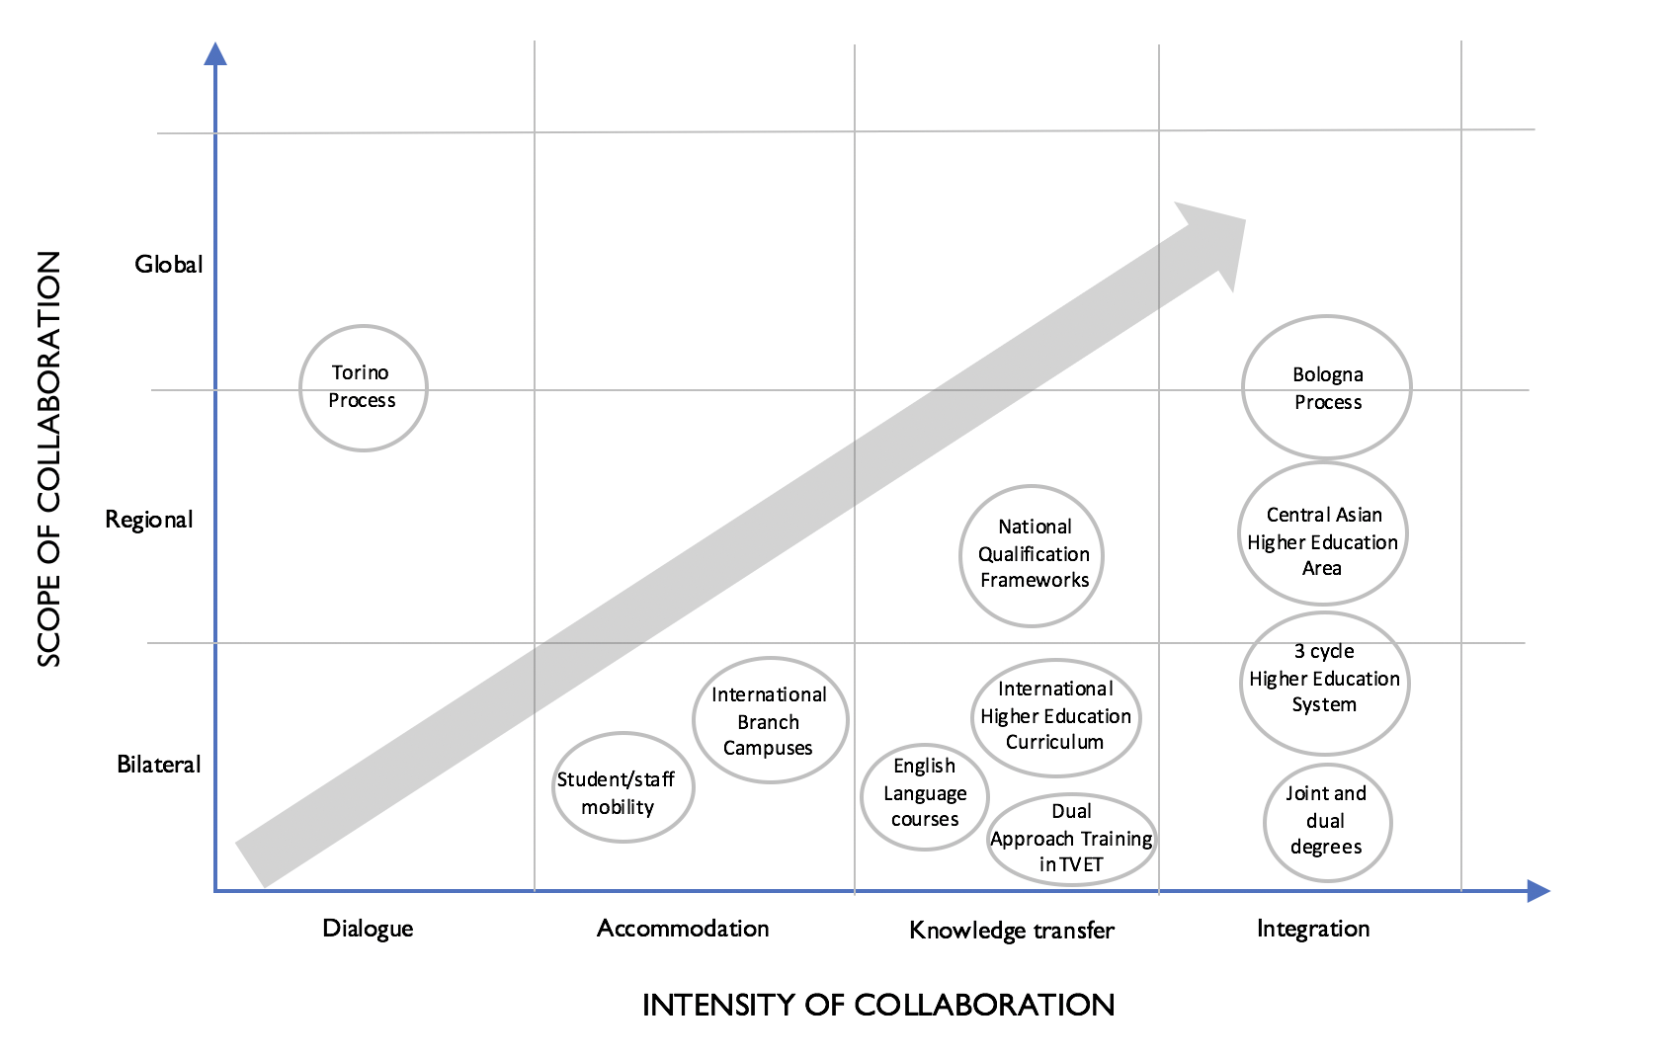
Intensity and Scope of International Collaboration in Higher Education and TVET in the CAREC Region

Slide 13
Integration
Membership or Compliance to the Bologna Process
Creation of the Central Asian Higher Educational Area (CAHEA)
Adoption of Three-cycle higher education systems
International joint and dual-degree programs

Slide 14
The Bologna Process
Widely considered the most ambitious regional higher-education reform initiatives ever undertaken.
Began in 1999: with 29 European countries, and one goal: bring coherence to higher education systems across the continent.
Encourages academic and workplace mobility
Increases compatibility and comparability of higher education qualifications, programs, and course content.
Process has since extended to 49 countries; beyond the borders of the European Union

Slide 15
Membership on International and Regional Higher Education Areas
Country | Bologna Process |  |  | Central Asian Higher Educational Area
 | Signatory |  | Compliant
 | Yes | Year Joined
Afghanistan
Azerbaijan | X | 2005
China
Georgia | X | 2005
Kazakhstan | X | 2010 |  | X
Kyrgyz Republic |  |  | X (2-cycle and ECTS) | X
Mongolia
Pakistan
Tajikistan |  |  | X (2-cycle and ECTS) | X
Turkmenistan |  |  | X (2-cycle) | X
Uzbekistan |  |  | X (2-cycle) | X

Slide 16
Integration
Membership or Compliance to the Bologna Process
Creation of the Central Asian Higher Educational Area (CAHEA)
Adoption of Three-cycle higher education systems
International joint and dual-degree programs

Slide 17
Membership on International and Regional Higher Education Areas
Country | Bologna Process |  |  | Central Asian Higher Educational Area
 | Signatory |  | Compliant
 | Yes | Year Joined
Afghanistan
Azerbaijan | X | 2005
China
Georgia | X | 2005
Kazakhstan | X | 2010 |  | X
Kyrgyz Republic |  |  | X (2-cycle and ECTS) | X
Mongolia
Pakistan
Tajikistan |  |  | X (2-cycle and ECTS) | X
Turkmenistan |  |  | X (2-cycle) | X
Uzbekistan |  |  | X (2-cycle) | X

Slide 18
Integration
Membership or Compliance to the Bologna Process
Creation of the Central Asian Higher Educational Area (CAHEA)
Adoption of Three-cycle higher education systems
International joint and dual-degree programs

Slide 19
Stages of Higher Education in the CAREC Region
Country | Three-cycle degree structure |  |  | Traditional track
 | Bachelor | Master | Doctorate | First | Second | Third
Afghanistan | Bachelor’s degree; 4-5years | Master’s Degree; 2 years | PhD; under development
Azerbaijan | Bakalavr;4-5 years | Magistr; 1.5-2 years | Doctor; 2-3 years
China | Bachelor’s; 4 years | Master’s; 2-3 years | Doctorate; 3 years with masters; 5 year with bachelor’s
Georgia | Bachelor’s; 4 years | Master’s; 2 years | Doctorate; 3 years
Kazakhstan | Bakalavriat; 4 years | Magistratura (1-2 years) | Doctorate; 3 years | Spetsialist; 5-6 years
Kyrgyz Republic | Bakalavr; 4 years | Magistr; 2 years |  | Diplom Specialista; 5 years | Aspirantura; 3 years | Doctoruntura
Mongolia | Bachelor’s; 4 years | Master’s; 2 years | Doctorate; 3 years
Pakistan | Bachelor’s; 4-5 years | Master’s; 2 years | Doctorate; 3-5 years
Tajikistan | Bakalavr; 4 years | Magistr; 2 years | Doctorate; 3-5 years | Mutakhassis; 5 year | Candidate of Science diplomas (Aspirantura) | Doctor of Science (Doctorontura)
Turkmenistan | Diplom Bakalavra; 4 years | Magstr; 1-2 years | Not applied | Hünärmeniň diplomy (Spetsialist) 5 years | Aspirantura; 3 years | Dokturantura; 3 years
Uzbekistan | Bakalavr;5 years | Magistr; 1.5-2 years | Doctor; 2-3 years
Source: Author’s analysis based on the International Association of Universities. “World Higher Education Database.” Paris, 2021. https

Slide 20
Integration
Membership or Compliance to the Bologna Process
Creation of the Central Asian Higher Educational Area (CAHEA)
Adoption of Three-cycle higher education systems
International joint and dual-degree programs

Slide 21
Policy Convergence Towards International Standards: Four Levels of Collaboration

Slide 22
Section 3: Remaining Challenges: Funding, Building and Maintaining Effective Skills Development Systems

Slide 23
Four Components on an Effective Skills System
4. Utilization of Developed Skills
Access to national, regional and international labor markets
3. Development of Needed Skills
Adequate quantity
High quality
Relevant to the needs of the labor market and the individual learner
Provide inclusive and equitable access
2. Identification of Needed Skills
Present
Future
1. Creation of a Governance Framework
Efficient management structure
Relevant policies
Adequate resources
Fair, efficient and transparent recruitment process to facilitate labor migration

Slide 24
Remaining Challenges in the CAREC Region
4. Utilization of Developed Skills
Access to national, regional and international labor markets
3. Development of Needed Skills
Adequate quantity
High quality
Relevant to the needs of the labor market and the individual learner
Provide inclusive and equitable access
2. Identification of Needed Skills
Present
Future
1. Creation of a Governance Framework
Efficient management structure
Relevant policies
Adequate resources
Fair, efficient and transparent recruitment process to facilitate labor migration

Slide 25
Remaining Challenges
Uneven spending in education in general, with only 4 CAREC countries spending more than the world average as a percentage of GDP.
Decreasing government investment in higher education since the 1990s, as well as low-levels of TVET funding
Efforts to improve labor market information and planning face implementation problems
An increase in number of higher education and TVET institutions but not in enrolment
General improvement in the quality of higher education in a few CAREC countries, particularly concerning a few “elite” schools; Yet, HE and TVET quality remains inadequate
Skills mismatch leading to low employment prospects, especially among TVET graduates.
Not sufficiently inclusive and equitable: financial and other barriers to accessing programs remain high; low attendance rates especially for poor households.
Lacks adequate and forward-looking policies and measures that directly improve the flow and utilization of knowledge and skills across countries.

Slide 26
Component 4: Utilizing Developed Skills in national, regional and international labor markets
International labor migration play a major and increasingly important role in regulating the supply and demand of labor in the region in the CAREC region
30 million emigrants currently originate from the CAREC region
The remittances, which refers to the money migrants sent home, are important for many CAREC members.

Slide 27
Personal remittances, received (percent of GDP)
Remittances facilitate human capital formation; improving access to education and health
Reduction of poverty, particularly within recipient households.
And unlike official development aid, remittances go directly to the households that needed them.
Source: Asian Development Bank
Source: Author’s calculations based on data from the Asian Development Bank

Slide 28
Component 4: Utilizing Developed Skills in national, regional and international labor markets
Migration is important not only to countries that received substantial amount of remittances but in all CAREC members, either as recipients or source of migrants or both.
Net immigrant stock, percent of population

Slide 29
Utilizing Developed Skills in national, regional and international labor markets
Given the historical and continued importance of migration in the CAREC region, any initiative on skills development needs to consider the impact of migration
Much of these significant and increasing migration flows occurs within convoluted recruitment system disconnected to training systems

Slide 30
Utilizing Developed Skills in national, regional and international labor markets
“brain waste” and workers exploitation
Inefficient and untransparent recruitment systems
Disconnect between recruitment and training systems

Slide 31
Section 4. Moving forward: Reinforcing Convergence and Making a case for an integrated approach on skills development

Slide 32
A Case for an Integrated Approach on Skills Development: Two-Pronged Approach
1. Reenforcing convergence: Building on progress already made on standardization and harmonization on HE and TVET
Supporting Bologna-inspired reforms
2. Setting missing foundations on governance of recruitment and information systems
Creating the necessary knowledge base on existing recruitment laws, regulations and practices in the CAREC region.
Comparing CAREC experience with the state of the art in international recruitment corridors to drive valuable lessons and learn from best practices
Supporting the Central Asian Higher Educational Area (CAHEA) and the TVET-focused Torino Process
Supporting of dual and/or joint programs and faculty and student exchanges;
Developing bilateral and/or regional qualifications, and establishing branch campuses
Creating CAREC-wide networks of universities and TVET providers
Developing a CAREC-wide Labor Force and Labor Market Database and Information system

Slide 33
A Case for an Integrated Approach on Skills Development: Two-Pronged Approach
1. Reenforcing convergence: Building on progress already made on standardization and harmonization on HE and TVET
Supporting Bologna-inspired reforms
2. Breaking new grounds: Setting missing foundations on governance of recruitment and information systems
Creating the necessary knowledge base on existing recruitment laws, regulations and practices in the CAREC region.
Comparing CAREC experience with the state of the art in international recruitment corridors to drive valuable lessons and learn from best practices
Supporting the Central Asian Higher Educational Area (CAHEA) and the TVET-focused Torino Process
Supporting of dual and/or joint programs and faculty and student exchanges;
Developing bilateral and/or regional qualifications, and establishing branch campuses
Creating CAREC-wide networks of universities and TVET providers
Developing a CAREC-wide Labor Force and Labor Market Database and Information system

Slide 34
Creating a Virtuous Circle: Towards an Integrated Approach Linking Standardization and Harmonization, Recruitment and Labor Force and Labor Market Information System

Slide 35
For more information: Dovelyn Rannveig Mendoza dmendoza@migrationpolicyanalysis.org
Thank you for your attention!

